Slide 1
PYTHON FULL STACK DEVELOPMENT

Slide 2
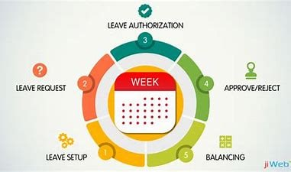
LEAVE MANAGEMENT SYSTEM
UNDER THE GUIDENCE OF
Madhu Priya Mam

Slide 3
TEAM MEMBERS
2110030054
PILLI VAISHNAVI
2110030203
MANISRI REDDY
2110030218
NAVYA REDDY
2110030233
RISHIKA REDDY

Slide 4
WHAT IS LEAVE MANAGEMENT SYSTEM ?
INTRODUCTION
A leave management system is an HR software that manages employee time-off requests in a smooth, accurate, transparent and efficient manner since leave management is one of the most time-consuming tasks in the HR department.
It is an automated system that helps HR to track requests for different types of leaves and helps in accepting or rejecting such leave requests and managing leave-related processes effortlessly.
Being an online leave management software based on the cloud, it also helps the employees with a portal for understanding their leave balance and your business leave policies and hence, the benefits of using it are multi-fold.

Slide 5
In the existing system, leaves are maintained using the attendance register for staff. The staff needs to submit their leaves manually to their respective authorities. This increases the paperwork & maintaining the records becomes tedious. Maintaining notices in the records also increases the paperwork.
PROBLEM STATEMENT

Slide 6
LITERATURE REVIEW
the project is the design and implementation of an interactive World Wide Web-based Leave Management System for the Human Resources Department at Texas A&M University-Corpus Christi. The Leave Management System automates the process of managing and tracking multiple types of employee leaves. Employees are able to submit the leave form, cancel previously submitted leave requests, check the status of leave requests and view completed leave transactions. The Leave Management System maintains a database to keep a running balance of each employees account, accrues employee vacation and sick credits and provides individual reports on employees leave accruals. The researcher learned that in their system the employee can check the leave request status in their leave transactions, keep an accurate records and provide individual report.

Slide 7
PROBLEMS IN PRESENT EXISTING SYSTEM
In the existing Employee Leave Management System, in almost every organization and firm, whenever an employee enters into the office, he/she has to either mark the attendance by themselves or else the manager came and take attendance which sometimes leads to extra attendance or short attendance as well as it is very time consuming too. In the existing system, the chances of losing the records is also very much.

Slide 8
PROJECT REQUIREMENTS
SOFTWARE REQUIREMENTS
FRONT END : PYTHON USING DJANGO
BACK END: DATABASE –MYSQL
CONTROL END: SOFTWARE ENGINEERING

Slide 9
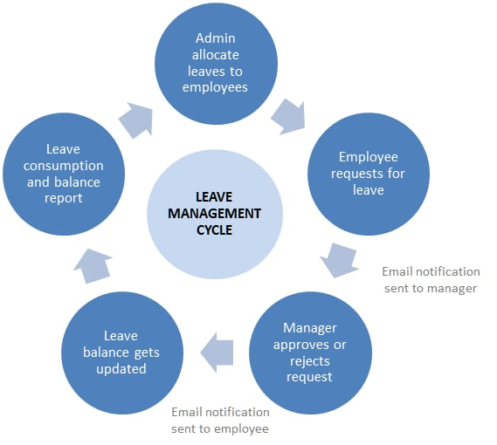
SYSTEM MODULES
Leave permits you to take time off from work for legitimate reasons, all with the formal approval of your supervisors through online.
REGISTER:
LOGIN:
LEAVES APPLIES:
LIVE REVIEW:
LEAVE APPROVAL:
LOGOUT:

Slide 10
MODULES DESCRIPTION
Register:
One user has to register on this interface with its actual data to be filled and applied in the same interface, then press enters to be saved in the database. Further, move to log in.
Login:
The user inputs its secure user id and password and enters the system. The user can log in multiple times as many times he wants.
Leave applies:
Here is the module for applying for leave to the interface. One has to enter his details about the leave like the reason for the leave.

Slide 11
Choose the dates of the leave: Depending upon the user’s account and policy of the company or premise the cost of the leave is calculated and shown to the interface. Live review: After successful application of the leave application is will come under scrutiny done by an admin. According to his need, he will review it and take necessary action in the next module. Leave approval: Here admin approves the leave or not is reflected by admin to the users. Here all the real-time updates will be shown to the users. Users can see only their own leave requests there. Log out: In the end, the user can log out the system to release the resources held for the purpose of anything else.

Slide 12

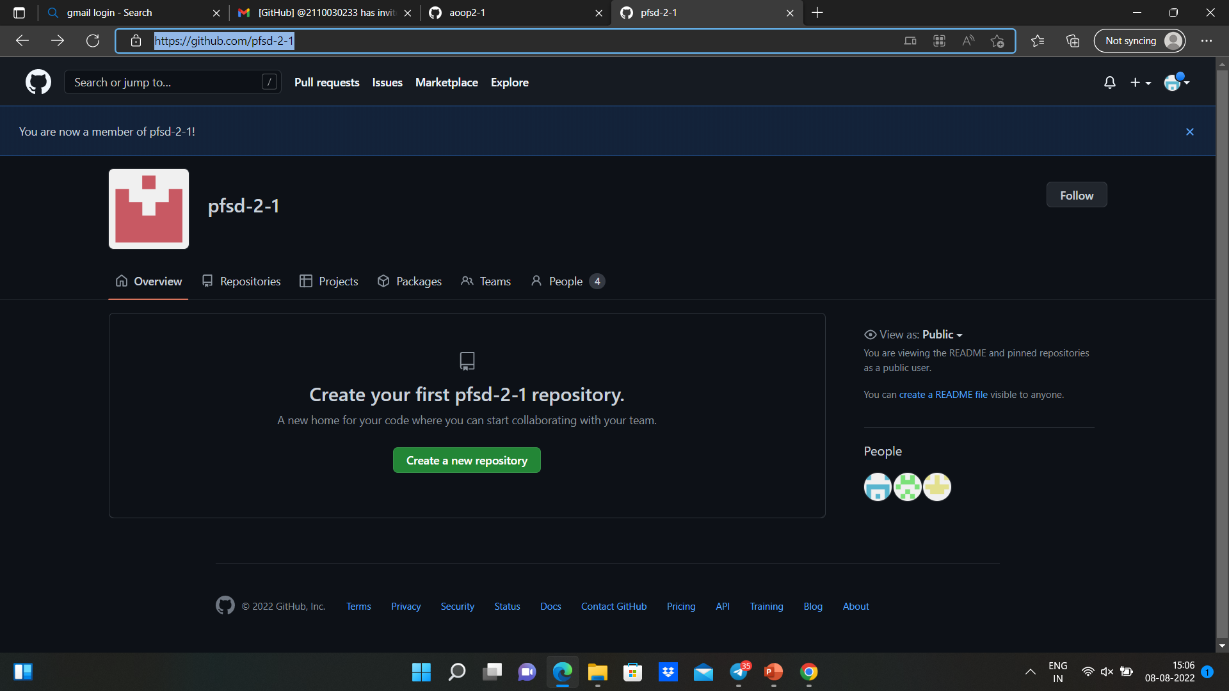
GITHUB SETUP
https://github.com/pfsd-2-1

Slide 13
GITHUB LINKS
https://github.com/2110030054
https://github.com/Manisrireddy
https://github.com/2110030218
https://github.com/2110030233

Slide 14
Data set collection
We have done research on various department employes and found that they are facing issues in maintaining the record of applying leaves and administering them.
So we decided to collect the data from the employee department ,conduct surveys and develop this system.
This makes it easier for them to help the employes and head of department to carry out their work comfortably in an easy way.

Slide 15
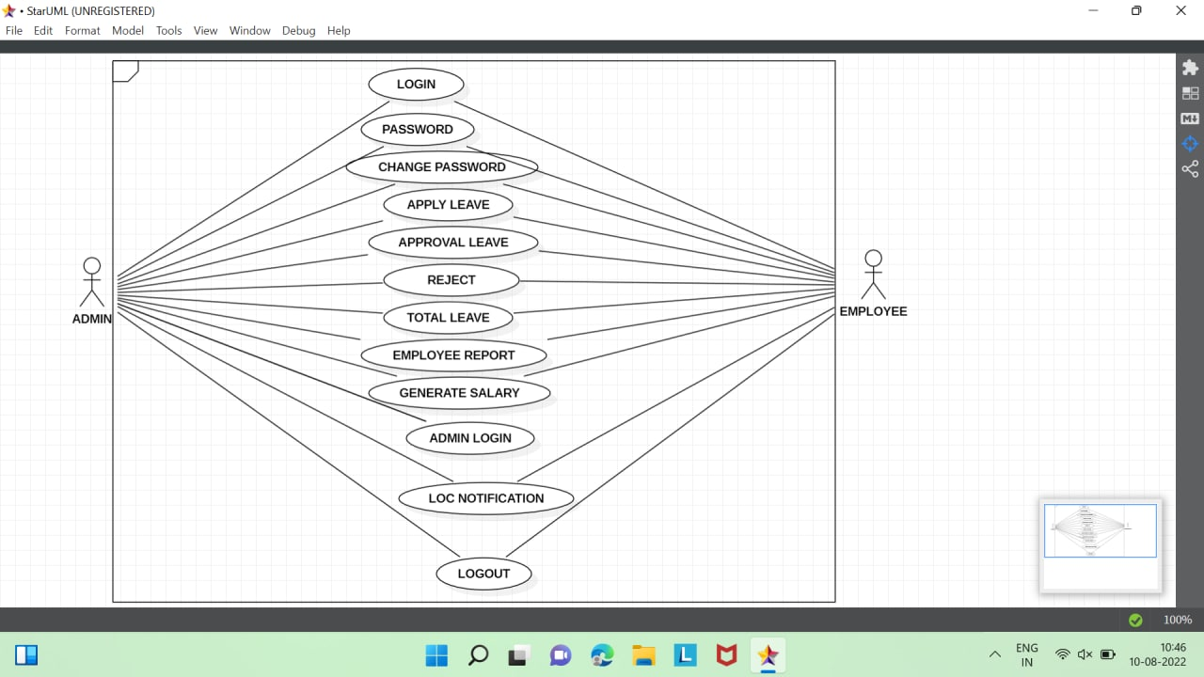
USE CASE DIAGRAM

Slide 16
TOOLS REQUIRED
CASE STUDIES
INTERVIEWS
SURVEYS
LITERARTURE REVIEWS
DJANGO
VISUAL STUDIO CODE

Slide 17

REFERRED ARTICLE:

Slide 18
WORK ALLOCATION TO TEAM MEMBERS
S.NO | ROLL.NO | NAME | WORK ALLOCATION
1 | 2110030054 | PILLI VAISHNAVI | REASEARCH&PPT
2 | 2110030203 | MANISRI | REASEARCH&PPT
3 | 2110030218 | NAVYA | REASEARCH&PPT
4 | 2110030233 | RISHIKA | REASEARCH&PPT

Slide 19
REFERENCES
https://www.lovelycoding.org/leave-management-system/
https://razorpay.com/payroll/learn/leave-management-system/
https://www.slideshare.net/muzammilsiddiq/leave-management-system-documentation-44924723
https://factohr.com/leave-management-guide/
https://www.youtube.com/watch?v=g8Qub6twpX4

Slide 20
THANK YOU

